Slide 1
Responding to Climate Change:
Avoiding the Unmanageable, Managing the Unavoidable
Eugene S. Takle
Professor
Department of Agronomy
Department of Geological and Atmospheric Science
Director, Climate Science Program
Iowa State University
Ames, IA 50011
Luther College Luncheon
Minneapolis
16 November 2012

Slide 2
Outline
Observed global changes in carbon dioxide and temperature
Projected future changes in global and US temperatures and precipitation
Adaptation already is happening
Mitigation must be a priority

Slide 3
Climate change is one of the most important issues facing humanity
The scientific evidence clearly indicates that our climate is changing, and that human activities have been identified as a dominant contributing cause.
Notes:
No disagreement in peer reviewed literature
Powerful statements from every major professional science society and organization in the world
Powerful statements from the National Academies of Sciences (the leadership in science) for every major country
G8 + 5 other countries, May 2009: “The need for urgent action to address climate change is now indisputable.”

Slide 4
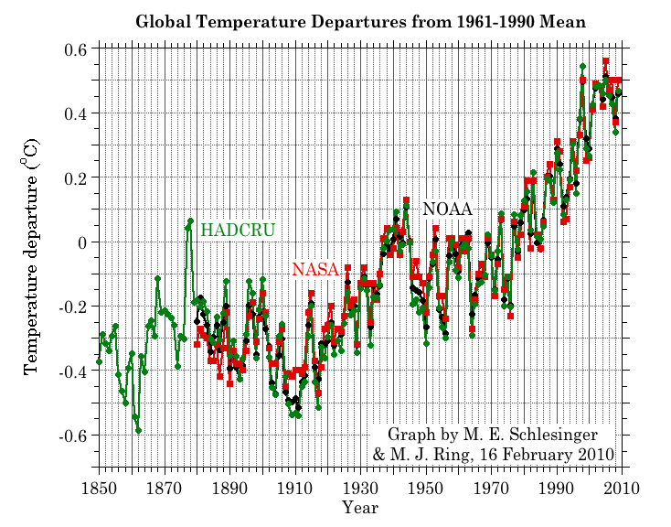
Three separate analyses of the temperature record – Trends are in close agreement
Don Wuebbles

Slide 5
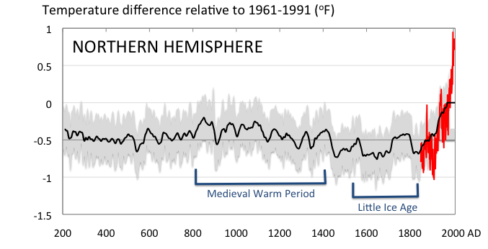
Conditions today are unusual in the context of the last 2,000 years …
Don Wuebbles

Slide 6
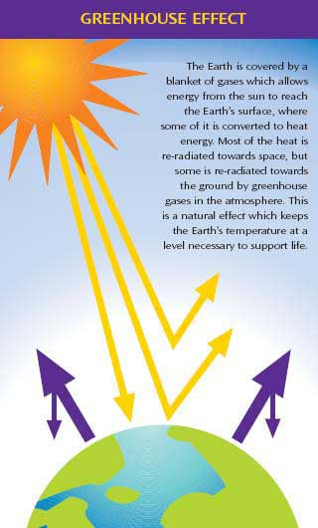
Why does the Earth warm?
1. Natural causes
THE GREENHOUSE EFFECT…
…is 100% natural.
  Heat is trapped in the atmosphere.
…sustains life on Earth.
  Keeps average temperatures at 12.8ºC (55ºF), instead of –29ºC (-20ºF).
Don Wuebbles

Slide 7
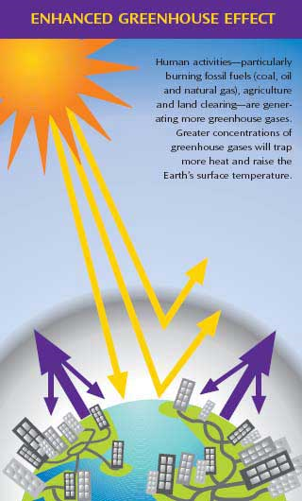
Why does the Earth warm?
2. Human causes
THE ENHANCED GREENHOUSE EFFECT
(or GLOBAL WARMING)
… is primarily human-induced: We’re increasing heat-trapping gases in the atmosphere.
… is like wrapping an extra blanket around the Earth.
Don Wuebbles

Slide 8
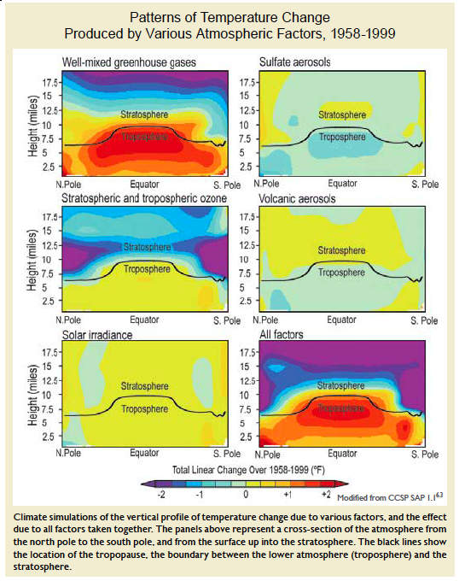
Warming of the Lower and Upper Atmosphere Produced by Natural and Human Causes
Karl, T. R., J. M. Melillo, and T. C. Peterson, (eds.), 2009: Global Climate Change Impacts in the United States. Cambridge University Press, 2009, 196pp.

Slide 9
Warming of the Lower and Upper Atmosphere Produced by Natural and Human Causes
Note that greenhouse gases have a unique temperature signature, with strong warming in the upper troposphere, cooling in the lower stratosphere and strong warming at the surface over the North Pole. No other warming factors have this signature.
Karl, T. R., J. M. Melillo, and T. C. Peterson, (eds.), 2009: Global Climate Change Impacts in the United States. Cambridge University Press, 2009, 196pp.

Slide 10
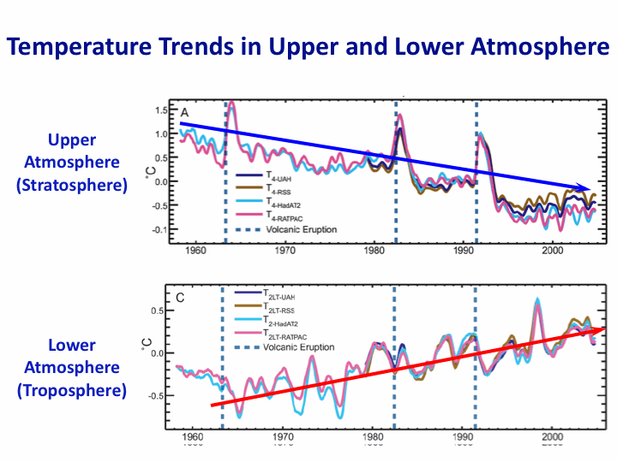
Warming of the Lower and Upper Atmosphere Produced by Natural and Human Causes
Note that greenhouse gases have a unique temperature signature, with strong warming in the upper troposphere, cooling in the lower stratosphere and strong warming at the surface over the North Pole. No other warming factors have this signature.
Karl, T. R., J. M. Melillo, and T. C. Peterson, (eds.), 2009: Global Climate Change Impacts in the United States. Cambridge University Press, 2009, 196pp.

Slide 11
Warming of the Lower and Upper Atmosphere Produced by Natural and Human Causes
Note that greenhouse gases have a unique temperature signature, with strong warming in the upper troposphere, cooling in the lower stratosphere and strong warming at the surface over the North Pole. No other warming factors have this signature.

Slide 12
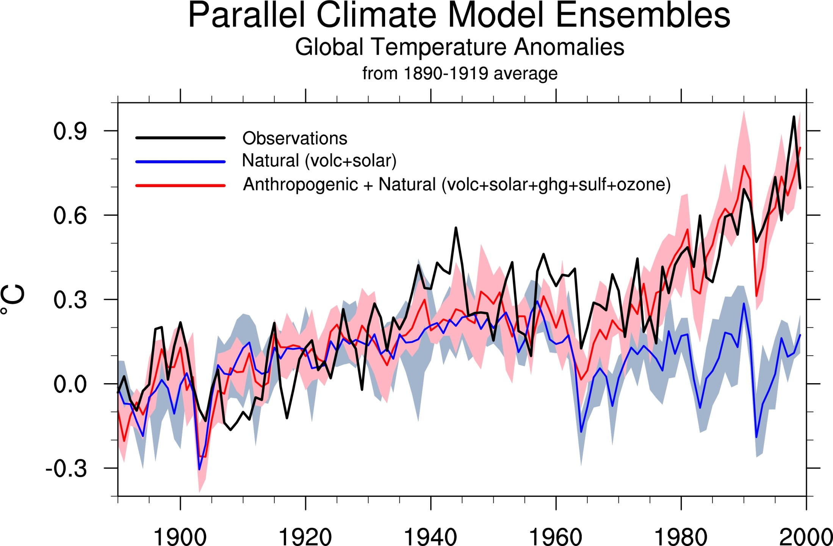
Climate models: Natural processes do not account for
observed 20th century warming after 1965
Jerry Meehl, National Center for Atmospheric Research

Slide 13
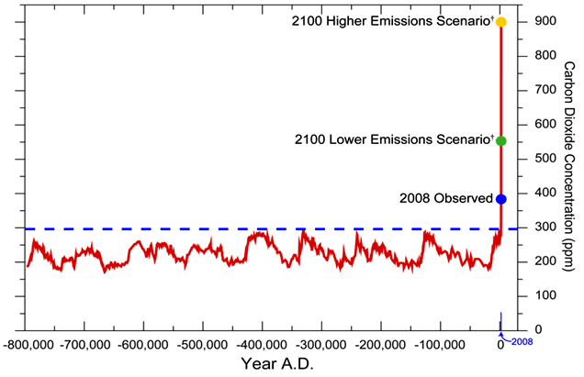
We have Moved Outside the Range of Historical Variation
800,000 Year Record of Carbon Dioxide Concentration
Don Wuebbles

Slide 14
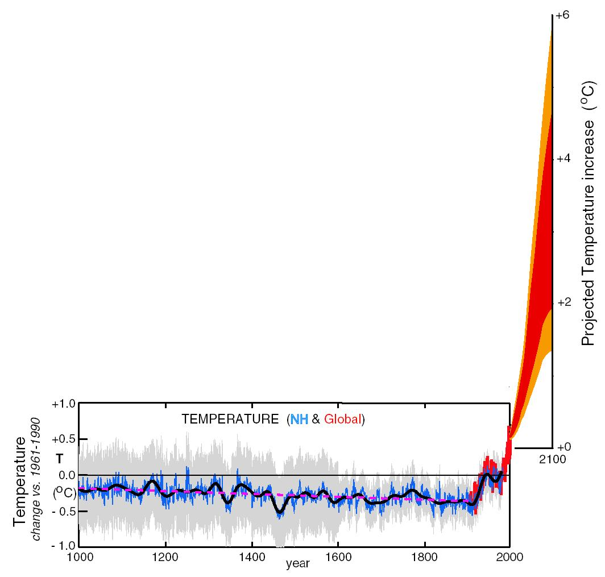
What can we expect in the future?
Don Wuebbles

Slide 15
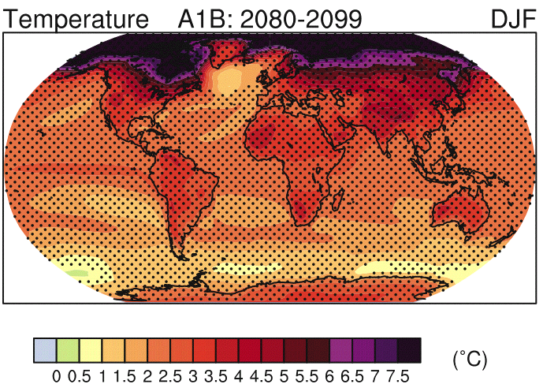
IPCC 2007

Slide 16
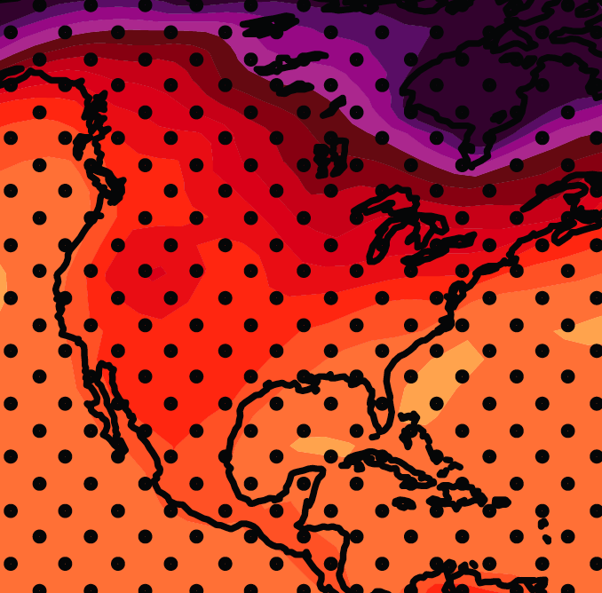
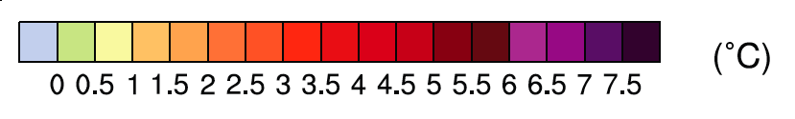
December-January-February Temperature Change
7.2ºF
6.3ºF
A1B Emission Scenario
2080-2099 minus1980-1999

Slide 17
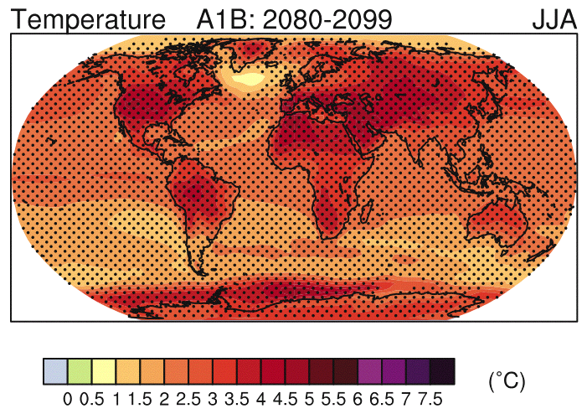
IPCC 2007

Slide 18
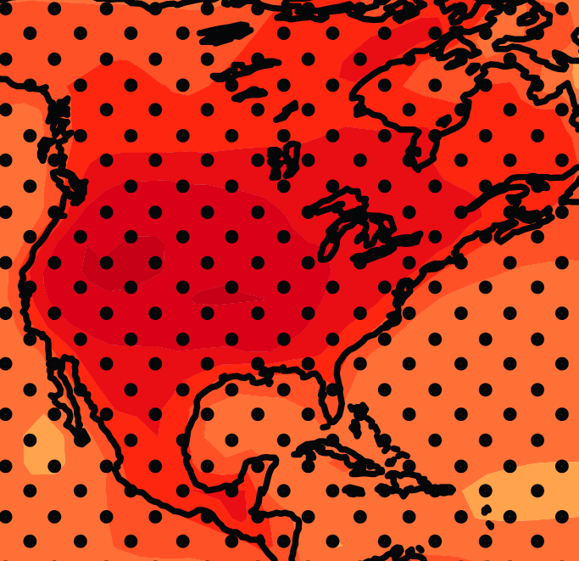
June-July-August Temperature Change
4.5ºF
5.4ºF
A1B Emission Scenario
2080-2099 minus1980-1999

Slide 19
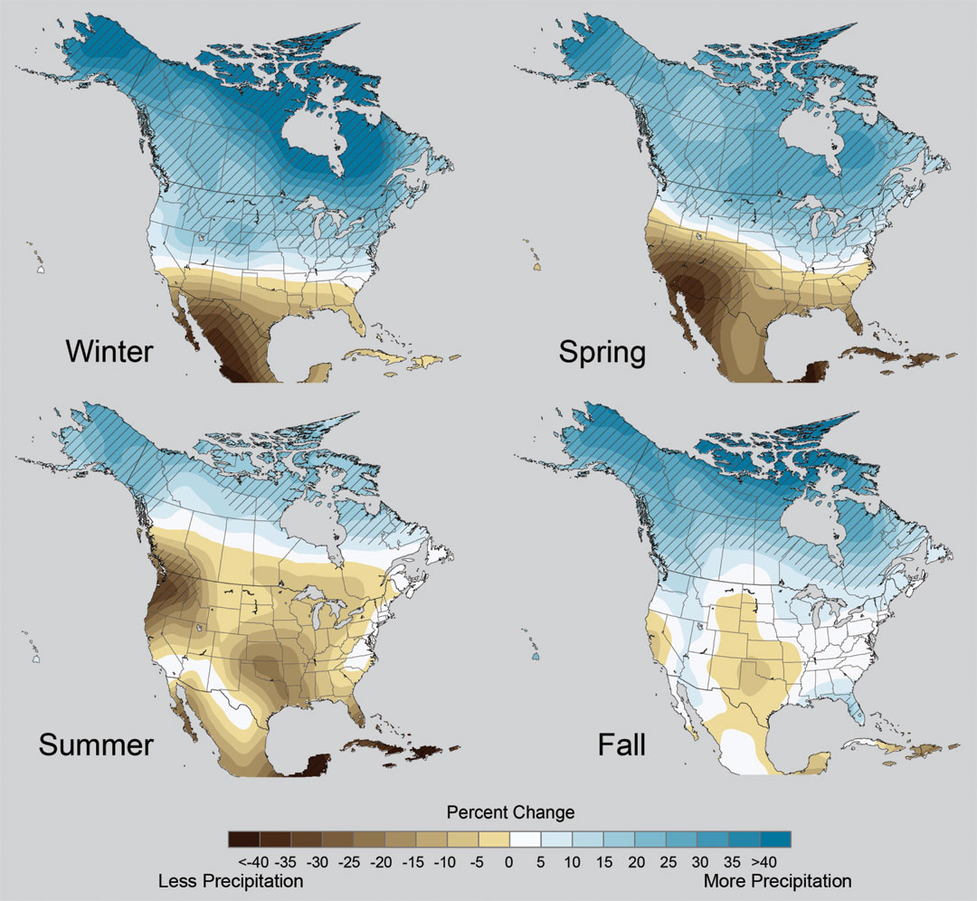
Projected Change in Precipitation: 2081-2099
Midwest: Increasing winter and spring precipitation, with drier summers
More frequent and intense periods of heavy rainfall
Unstippled regions indicate reduced confidence
Relative to 1960-1990
NOTE: Scale Reversed
Don Wuebbles

Slide 20
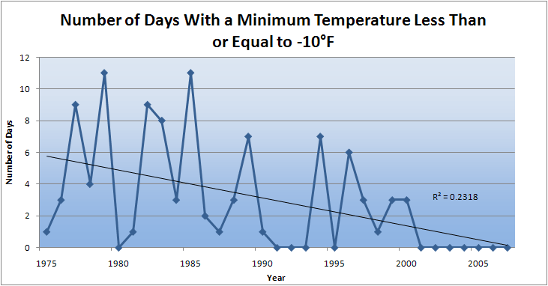
Des Moines Airport Data
Caution: Not corrected for urban heat island effects

Slide 21
Des Moines Airport Data
1983: 13
1988: 10
1977: 8
1974: 7

Slide 22
Des Moines Airport Data
1983: 13
1988: 10
1977: 8
1974: 7
6 days ≥ 100ºF in 23 years

Slide 23
Des Moines Airport Data
1983: 13
11 days in 2012
1988: 10
1977: 8
1974: 7
6 days ≥ 100ºF in 23 years

Slide 24
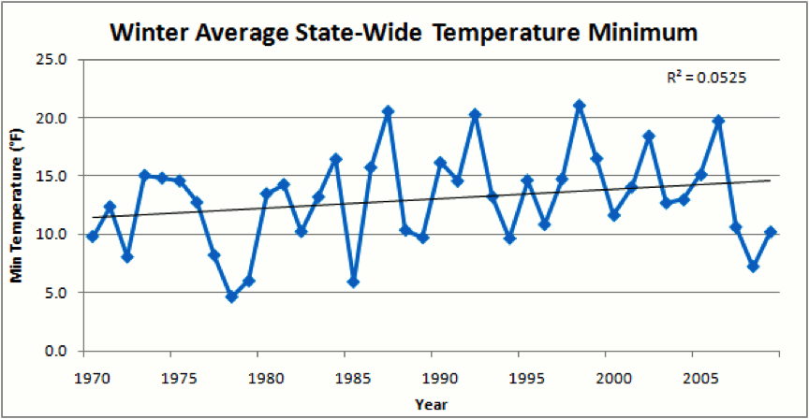
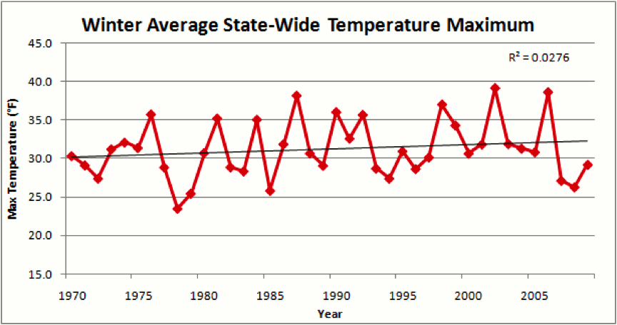
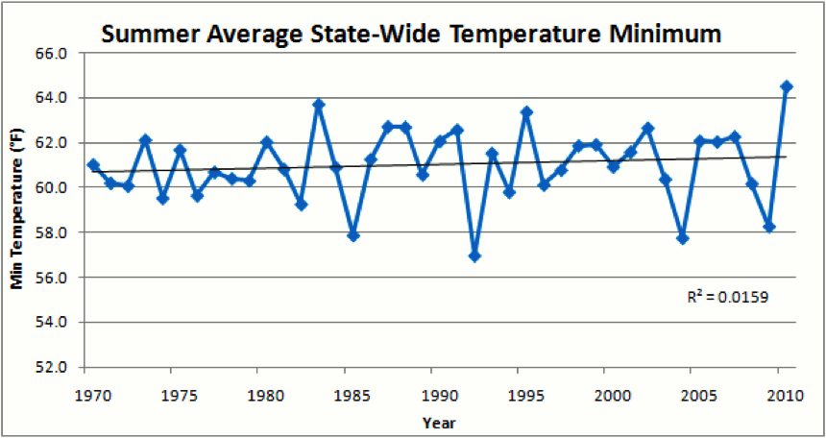
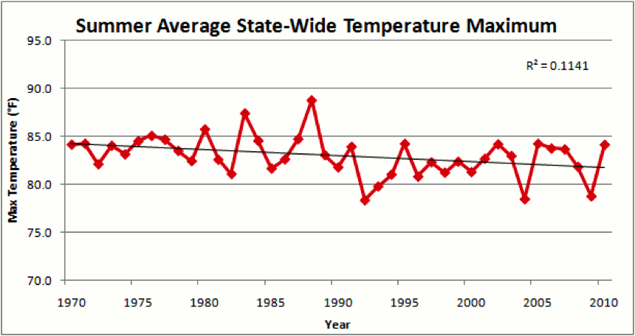

Slide 26
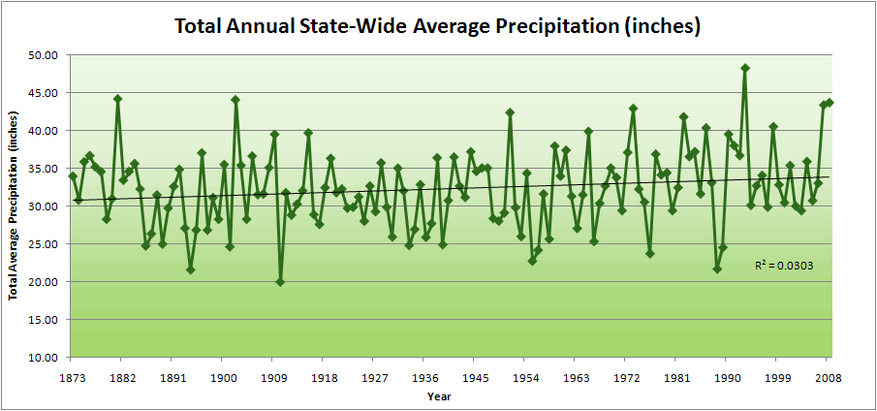
Iowa State-Wide Average Data

Slide 27
Iowa State-Wide Average Data
34.0”
10% increase
30.8”

Slide 28
Iowa State-Wide Average Data
Totals above 40”
2 years
34.0”
10% increase
30.8”

Slide 29
Iowa State-Wide Average Data
Totals above 40”
2 years
8 years
34.0”
10% increase
30.8”

Slide 30
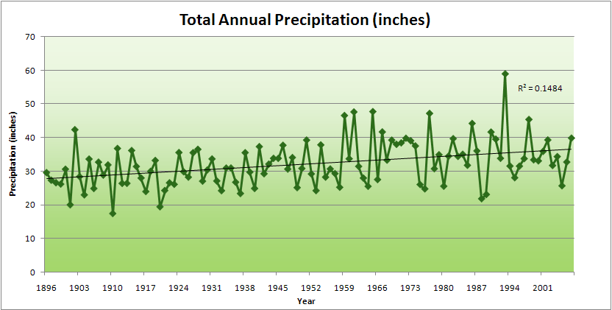
Cedar Rapids Data

Slide 31
Cedar Rapids Data
28.0”
32% increase
37.0”

Slide 32
Cedar Rapids Data
Years with more than 40 inches
11
1
28.0”
32% increase
37.0”

Slide 33
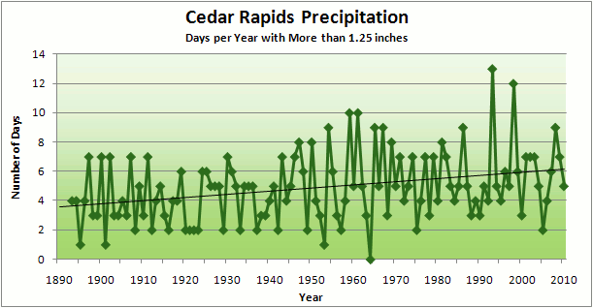
Cedar Rapids Data
3.6 days
67% increase
6.0 days

Slide 34
Cedar Rapids Data
Number of Years with More than 8 Occurrences
0
9
3.6 days
67% increase
6.0 days

Slide 35
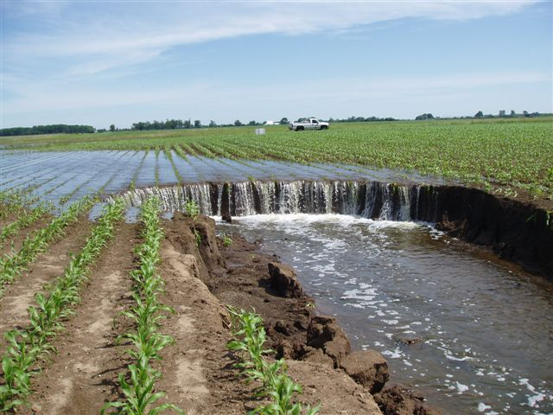
Photo courtesy of RM Cruse

Slide 36
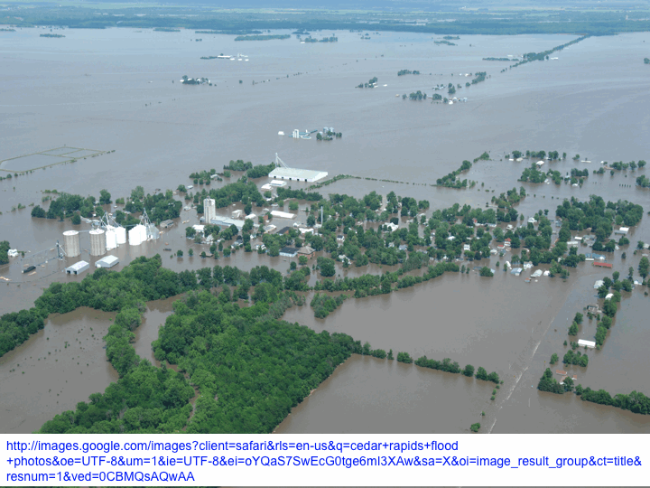

Slide 37
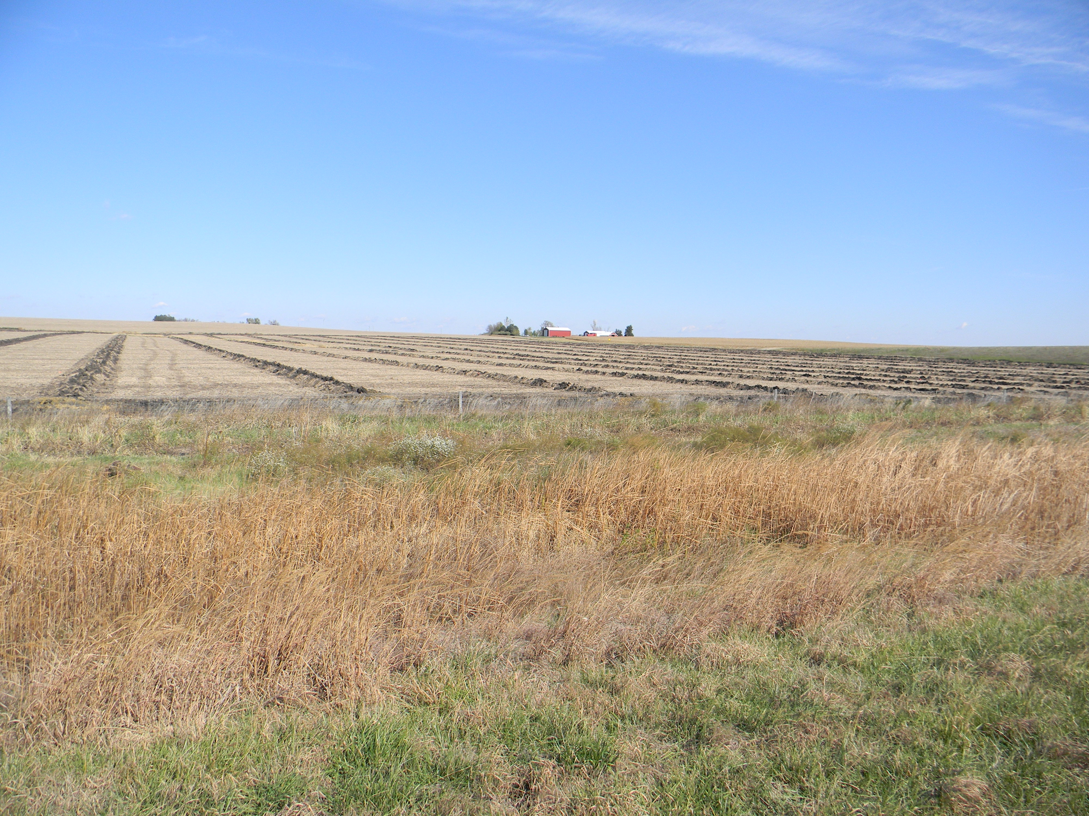

Slide 38
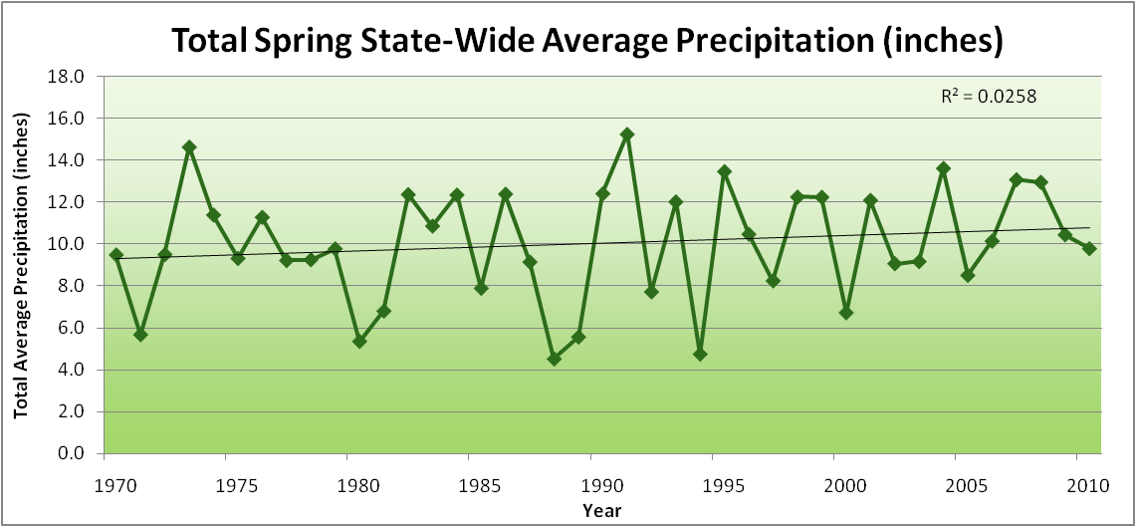
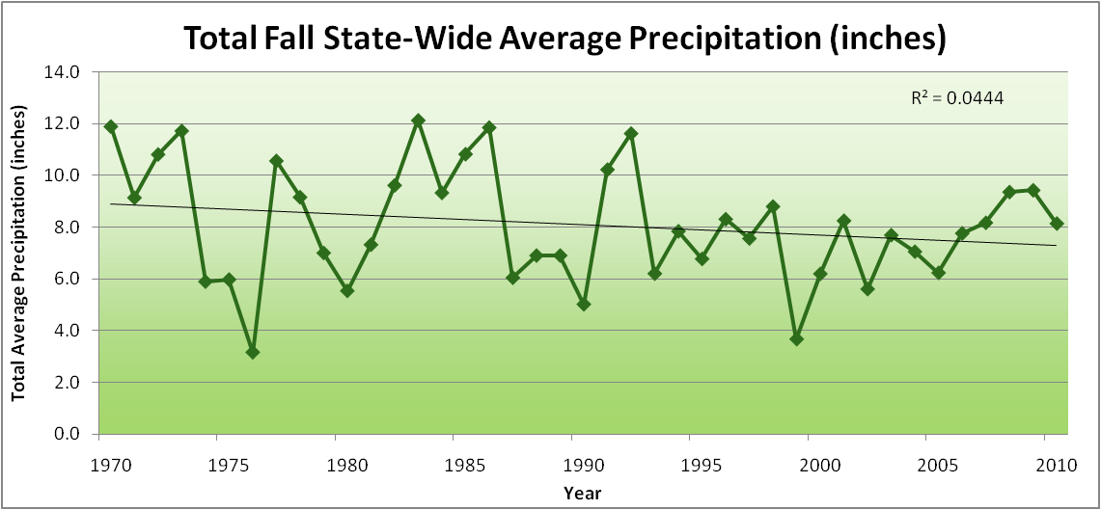
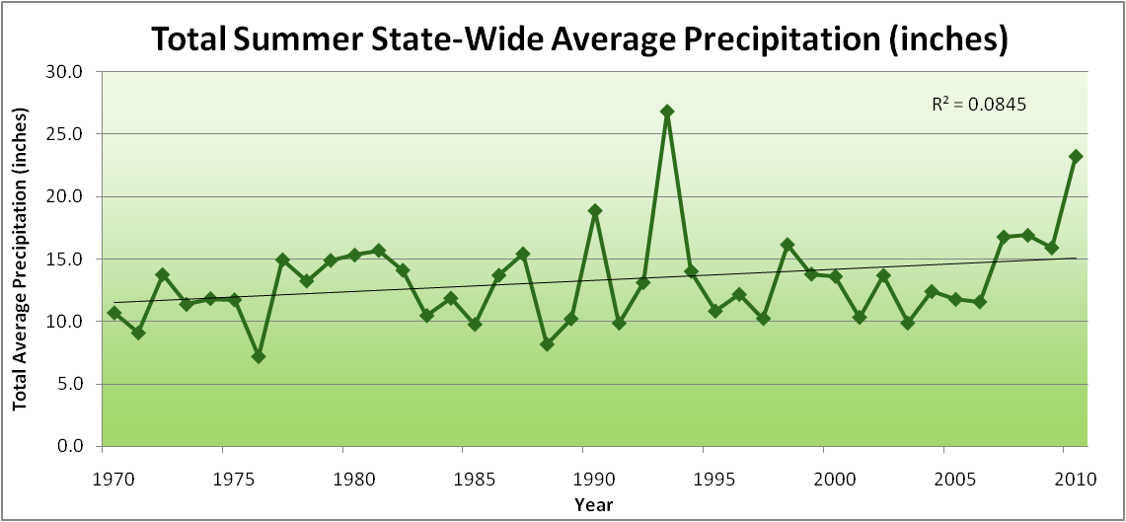
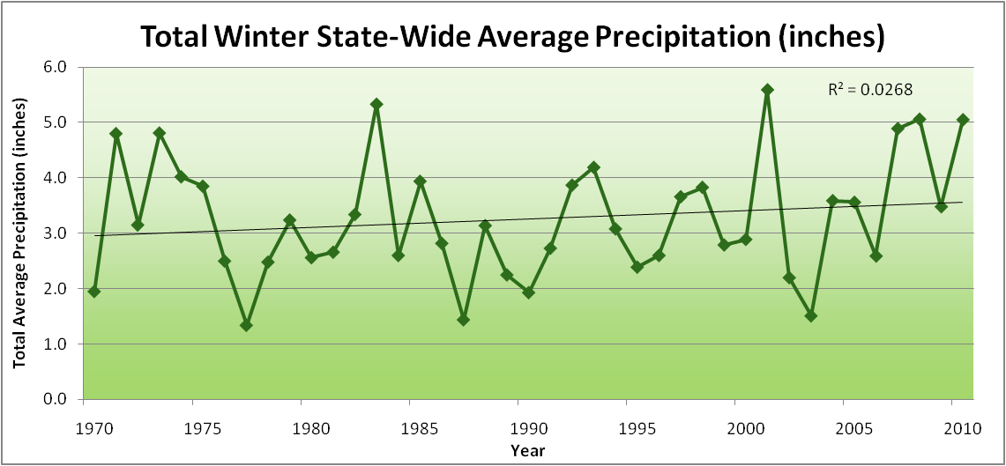
Amplification of the Seasonality of Precipitation
Spring
Fall
Summer
Winter

Slide 39
Amplification of the Seasonality of Precipitation
Spring
Fall
Summer
Winter

Slide 40
Amplification of the Seasonality of Precipitation
Spring
Fall
21.2 => 25.3 inches (22% increase)
12.1 => 10.5 inches (13% decrease)
Summer
Winter

Slide 41
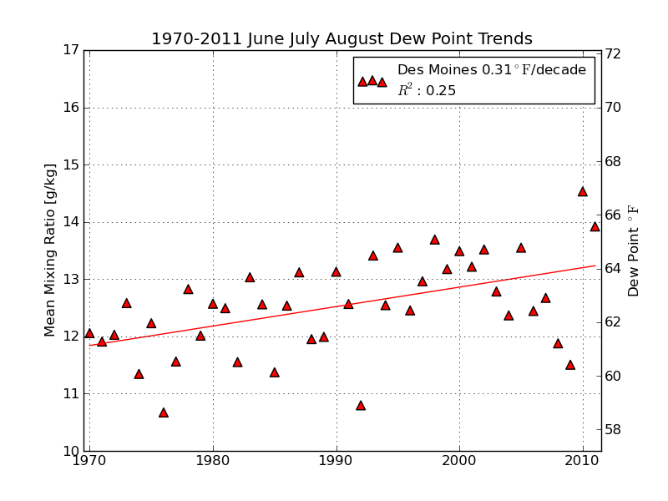
Mean Summer (JJA) Dew-Point Temperatures for Des Moines, IA
Rise of 3ºF in 42 years
12% rise in water content in 42 years

Slide 42
Managing the Unavoidable :
Adaptation to Climate Change

Slide 43
Iowa Agricultural Producers are Adapting to Climate Change:
Longer growing season: plant earlier, plant longer season hybrids, harvest later
Wetter springs: larger machinery enables planting in smaller weather windows
More summer precipitation: higher planting densities for higher yields
Wetter springs and summers: more subsurface drainage tile is being installed, closer spacing, sloped surfaces
Fewer extreme heat events: higher planting densities, fewer pollination failures
Higher humidity: more spraying for pathogens favored by moist conditions. more problems with fall crop dry-down, wider bean heads for faster harvest due to shorter harvest period during the daytime.
Drier autumns: delay harvest to take advantage of natural dry-down conditions, thereby reducing fuel costs
HIGHER YIELDS!!
Is it genetics or climate? Likely some of each.

Slide 44
So what about droughts in the future?

Slide 45
Iowa State-Wide Average Data
Totals above 40”
2 years
8 years
34.0”
10% increase
30.8”

Slide 46
Iowa State-Wide Average Data
Totals above 40”
2 years
8 years
3 years
5 years
2012?
Totals below 25”

Slide 47
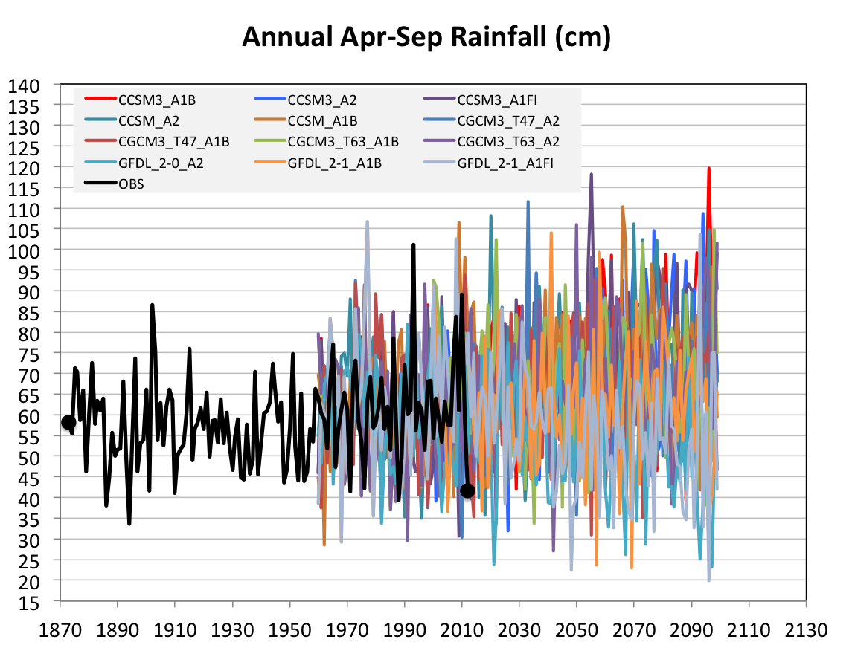
Future Variability in Growing Season Precipitation for Iowa
More extreme floods
More extreme droughts
CJ Anderson, ISU

Slide 48
Future Variability in Growing Season Precipitation for Iowa
More extreme floods
Lines drawn by eye
More extreme droughts
CJ Anderson, ISU

Slide 49
Avoiding the Unmanageable :
Mitigating Impacts of Global Climate Change

Slide 50
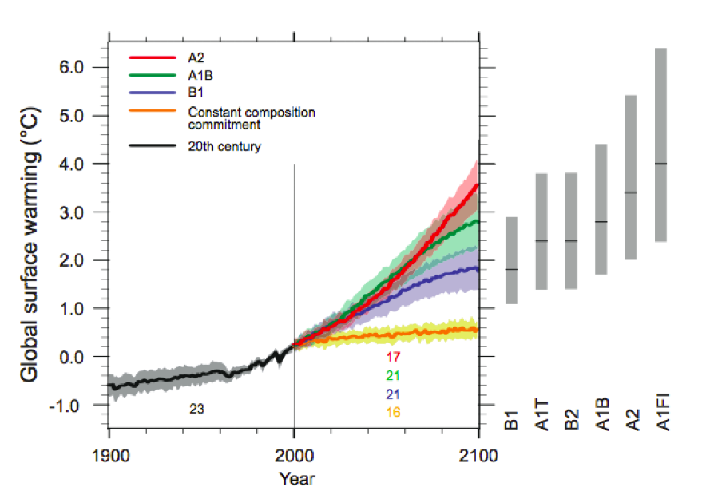
Energy intensive
Balanced fuel sources
More environmentally friendly
Limit to avoid “dangerous anthropogenic
Interference” with the climate system
2ºC limit
IPCC Fourth Assessment Report Summary for Policy Makers

Slide 51
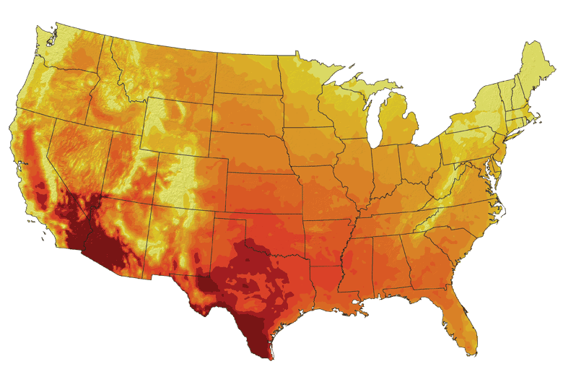
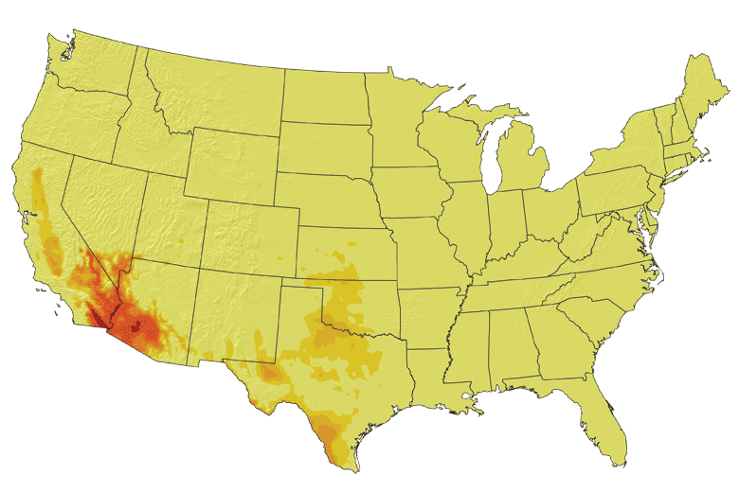
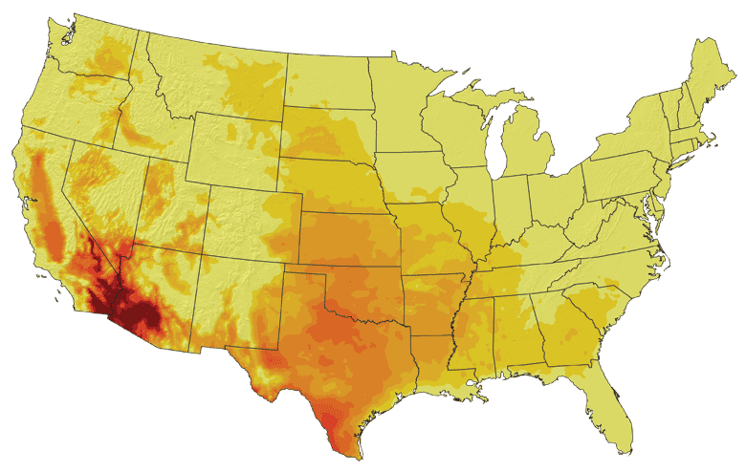
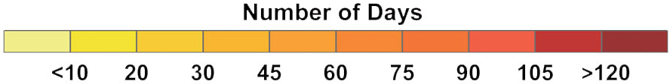
Increases in very high temperatures will have
wide-ranging effects
Higher Emissions Scenario, 2080-2099
Number of Days Over 100ºF
Recent Past, 1961-1979
Average:
30-60 days
Lower Emissions Scenario, 2080-2099
Average:
10-20 days
Don Wuebbles

Slide 52
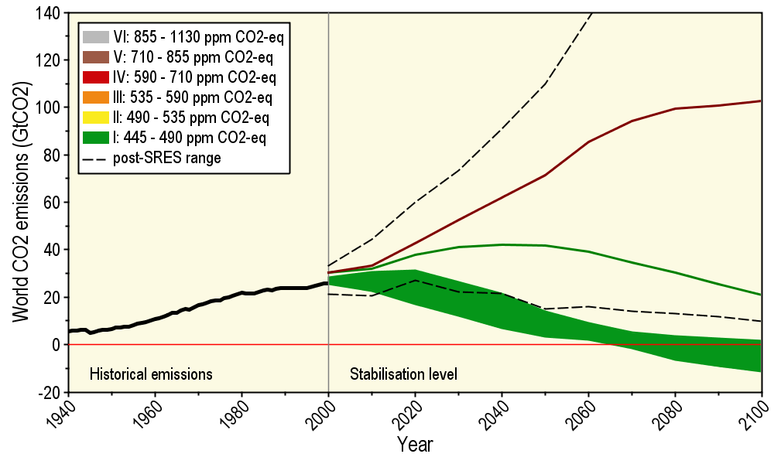
Long-Term Stabilization Profiles
A2
B1
Nebojša Nakićenović IIASA, Vienna

Slide 53
Long-Term Stabilization Profiles
A2
Achieving this emission reduction scenario will provide a 50% chance of not exceeding the 2ºC guardrail
B1
2008
2009
Nebojša Nakićenović IIASA, Vienna

Slide 54
Long-Term Stabilization Profiles
A2
Achieving this emission reduction scenario will provide a 50% chance of not exceeding the 2ºC guardrail
B1
Carbon reductions needed will be 90 times as large
as the impact of the 2009 recession
2008
2009
Nebojša Nakićenović IIASA, Vienna

Slide 55
Summary
Global temperature trends of the 20C cannot be explained on the basis of natural variation alone
Only when the influences of greenhouse gases and sulfate aerosols are included can the trends be explained
Models that explain these trends, when projected into the future, indicate a 1.5-6.5ºC warming over the 21C
Iowa farmers and cities already are paying to cope with climate change
Substantial adverse consequences to food production, fresh-water supplies, and sustainability will occur for temperature increases above 2ºC
The major challenge to our global society is to figure out how to reduce our global dependence on carbon-emitting fuels

Slide 56
For More Information:
Climate Science Program
Iowa State University
http://climate.engineering.iastate.edu/
gstakle@iastate.edu
Iowa Flood Center
University of Iowa
http://www.iowafloodcenter.org/
witold-krajewski@uiowa.edu

